Slide 1

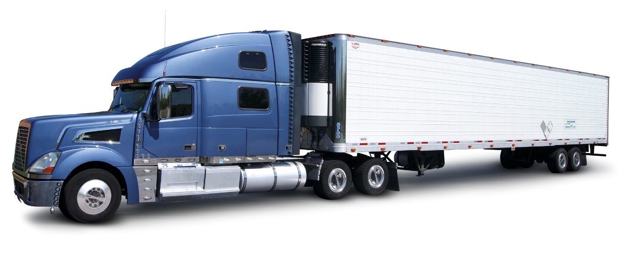
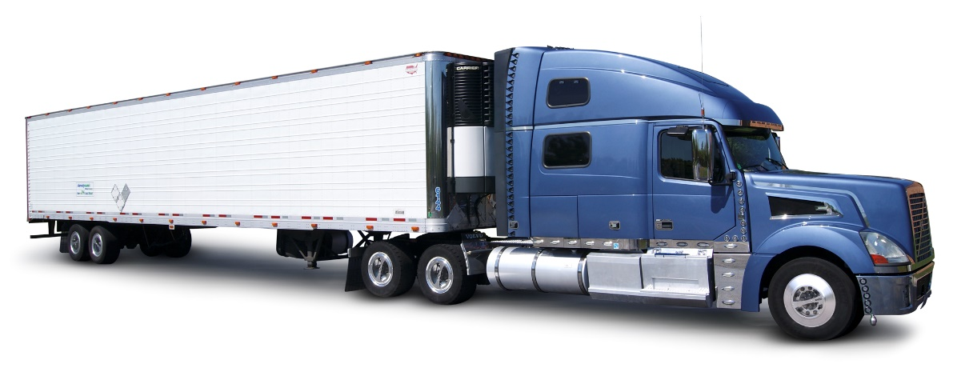
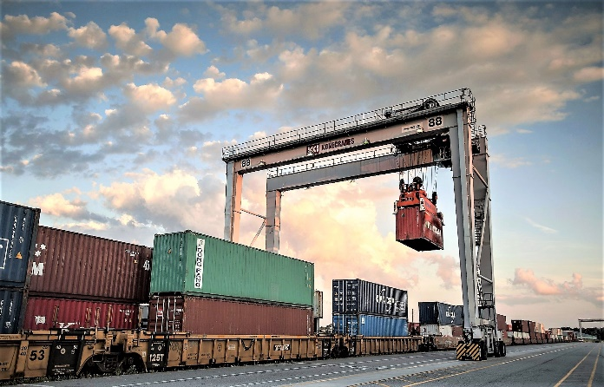
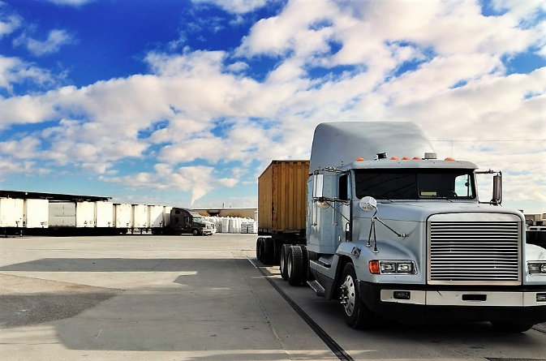
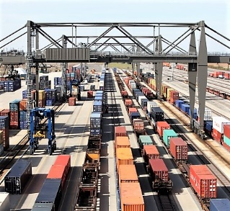

INTERMODAL INSPECTION PROGRAM
J.S. Blake: President
N. Schuyler: Vice President
Notes:
The Chicago Car Interchange Bureau Intermodal Inspection Program
Notes:

Slide 2
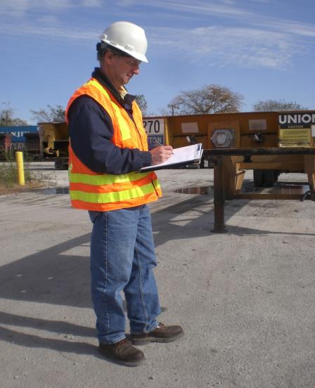
SAFETY
Recommended PPE:
Hard Hat
Enhanced Visibility Workwear
Safety Glasses
6” Lace-up Steel Toe Boots

Slide 3
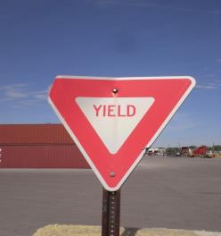
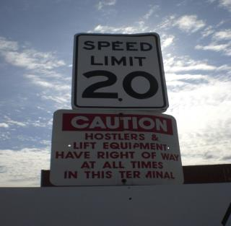
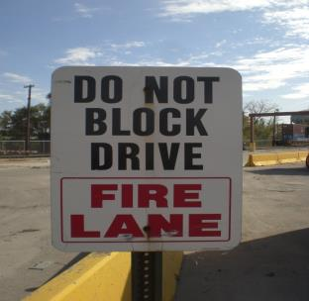
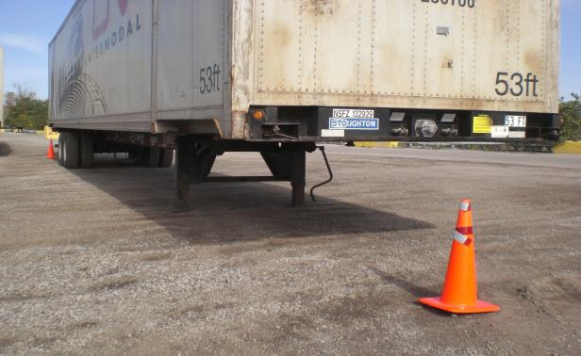

Slide 4
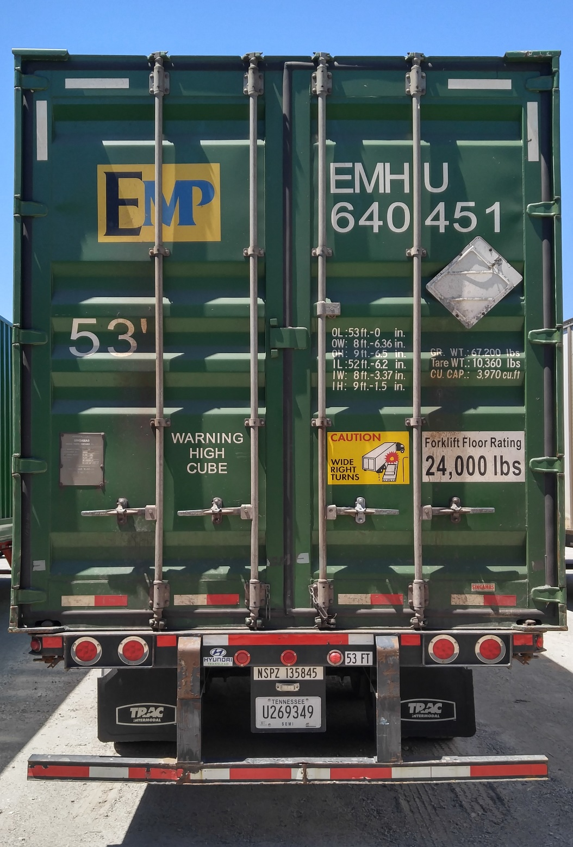
Left
(L)
Right
(R)

Slide 5
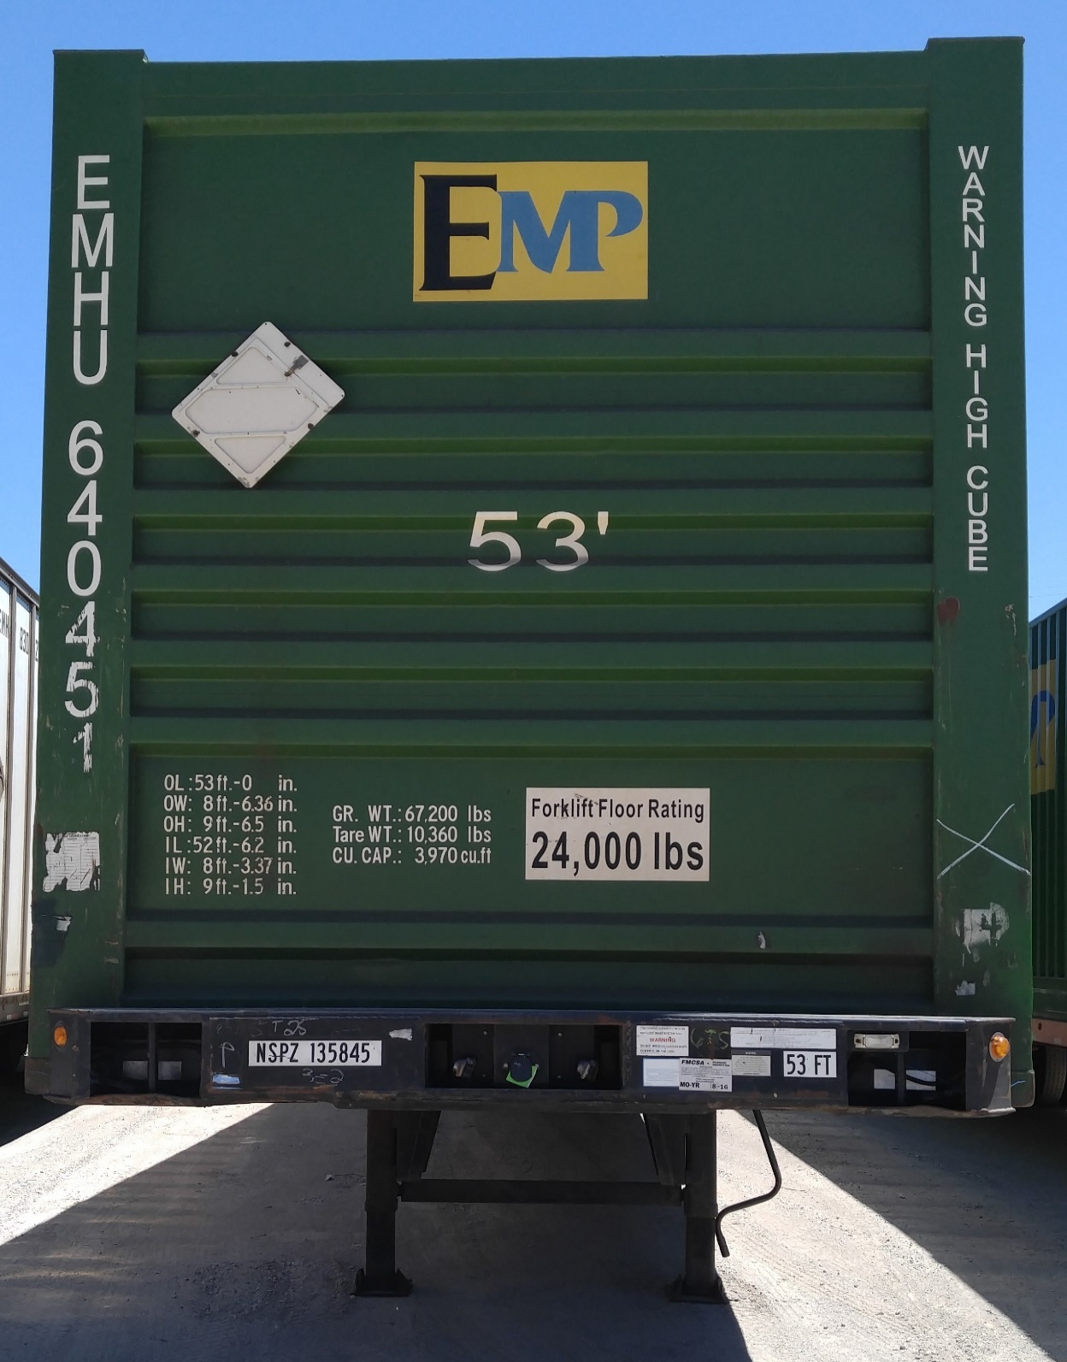
Right
(R)
Left
(L)

Slide 6
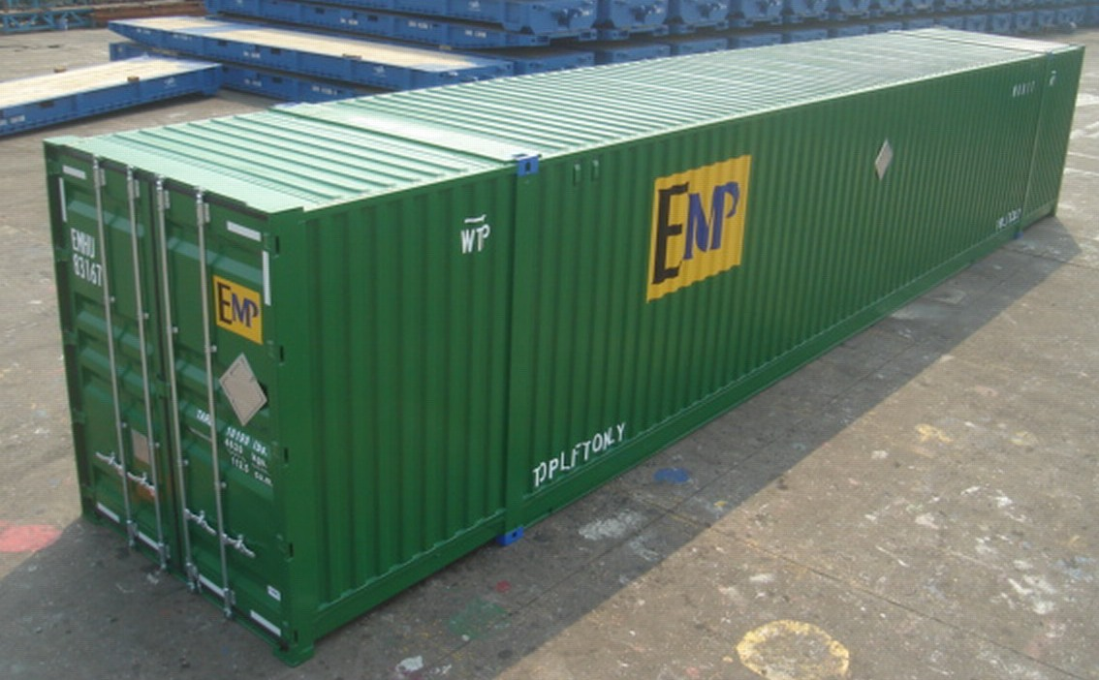
Steel
Container
Intermediate Headers
Top Front
(TF)
Top Center
(TC)
Right Side Front
(RSF)
Top Rear
(TR)
Right Side Center
(RSC)
Right Side Rear
(RSR)
Stacking Posts

Slide 7
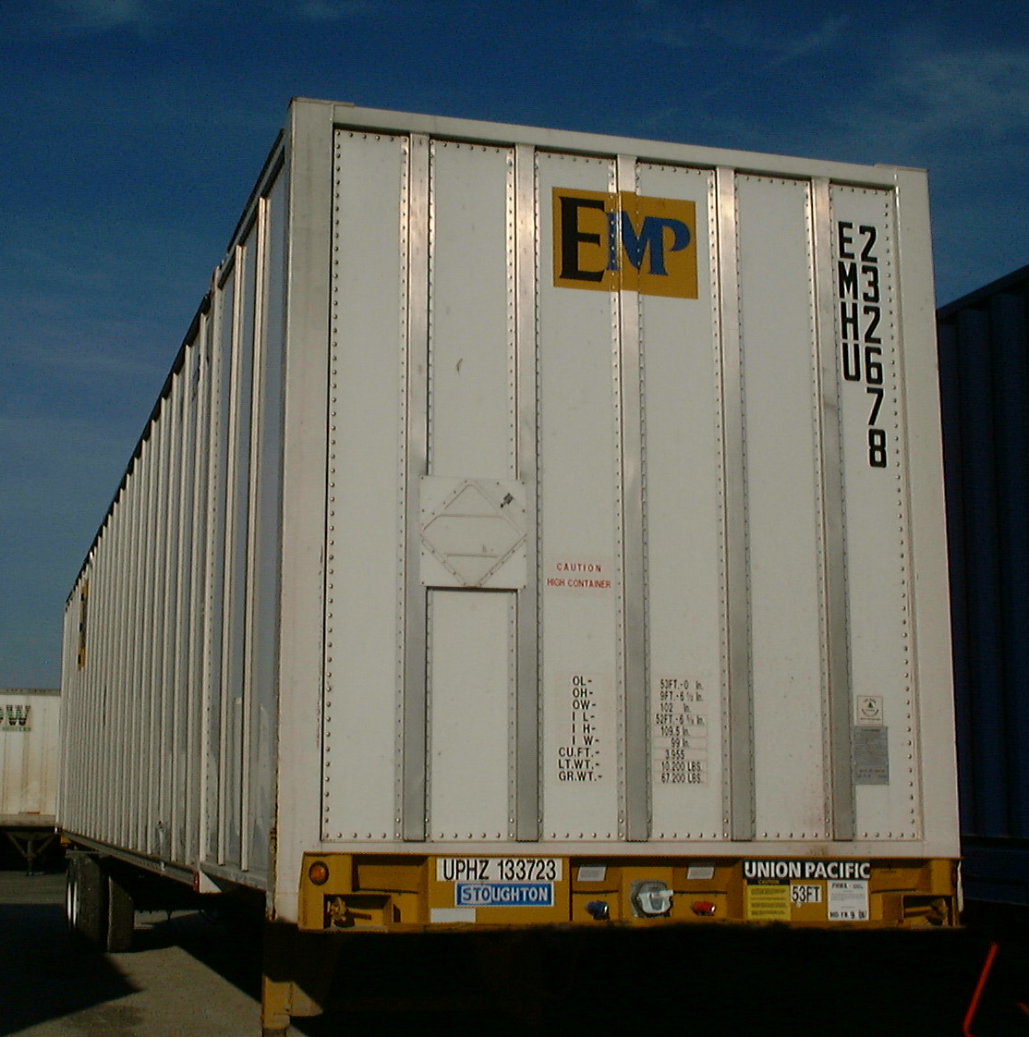
Aluminum
Container
TOP NOSE RAIL
TOP SIDE RAIL
EXTERIOR SIDE POST
EXTERIOR NOSE POSTS
CORNER
POST
STACKING POST
NOSE PANELS
SIDE PANEL
BOTTOM SIDE RAIL
FRONT CHASSIS BOLSTER
Notes:
Parts of a Domestic container

Slide 8
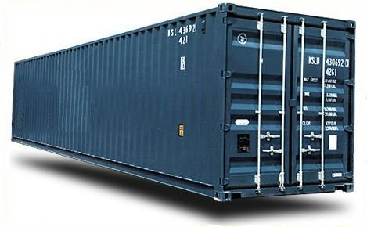
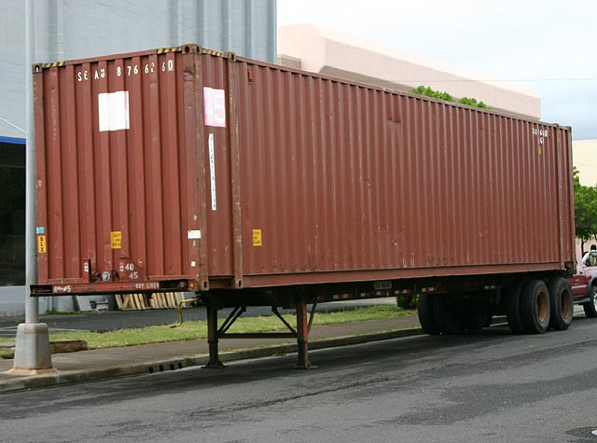
Top rail
Steel boxes 40ft. and under have corner castings
Steel boxes 45ft. and over have stacking posts
Bottom rail
Corrugated panels

Slide 9
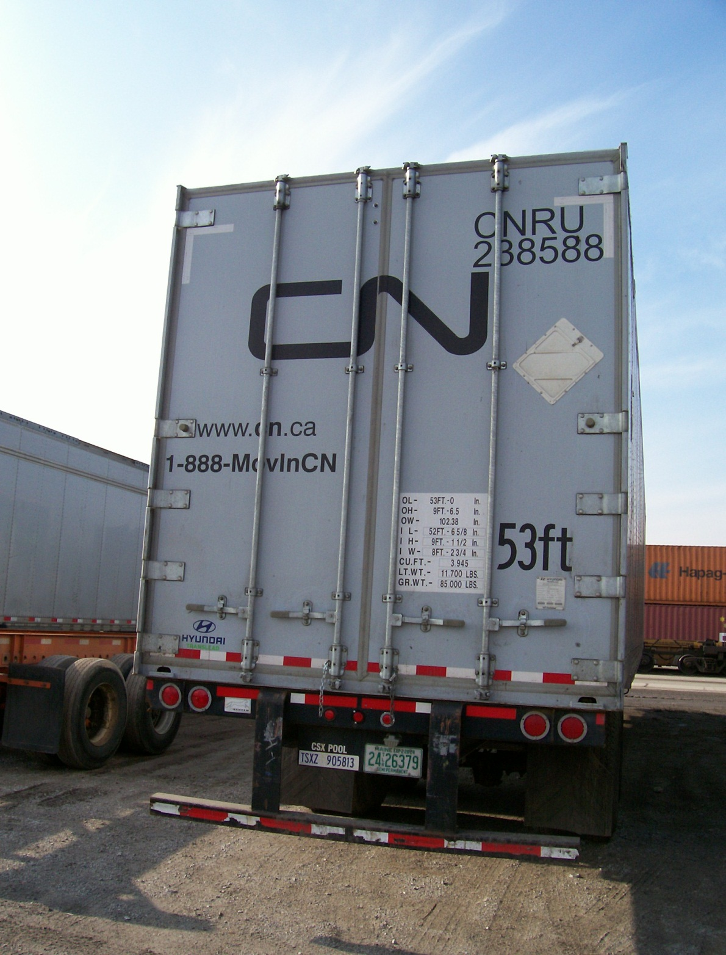
Door Header
Door Post/JBar
Hinges
Left Rear Door
Lockrods
Rear Door Sill
DOT Under- Ride Guard

Slide 10
Roof sheet
Roof bows
Interior side plyliners
Scuffliner
Floor
Notes:
Roof sheet, Roof bows, Interior side plyliners, Scuffliner, and Floor
Notes:

Slide 11
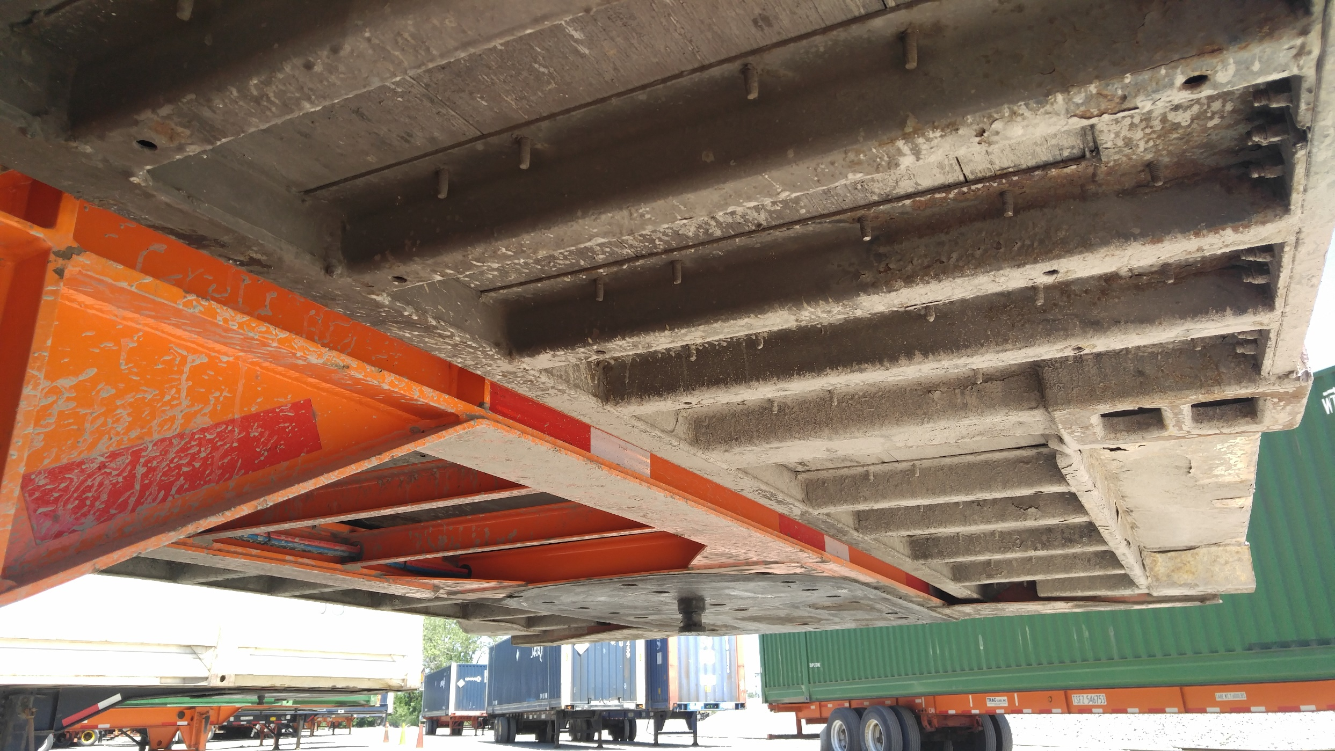
Outriggers
Chassis
Bottom Rail
Tunnel Rail

Slide 12
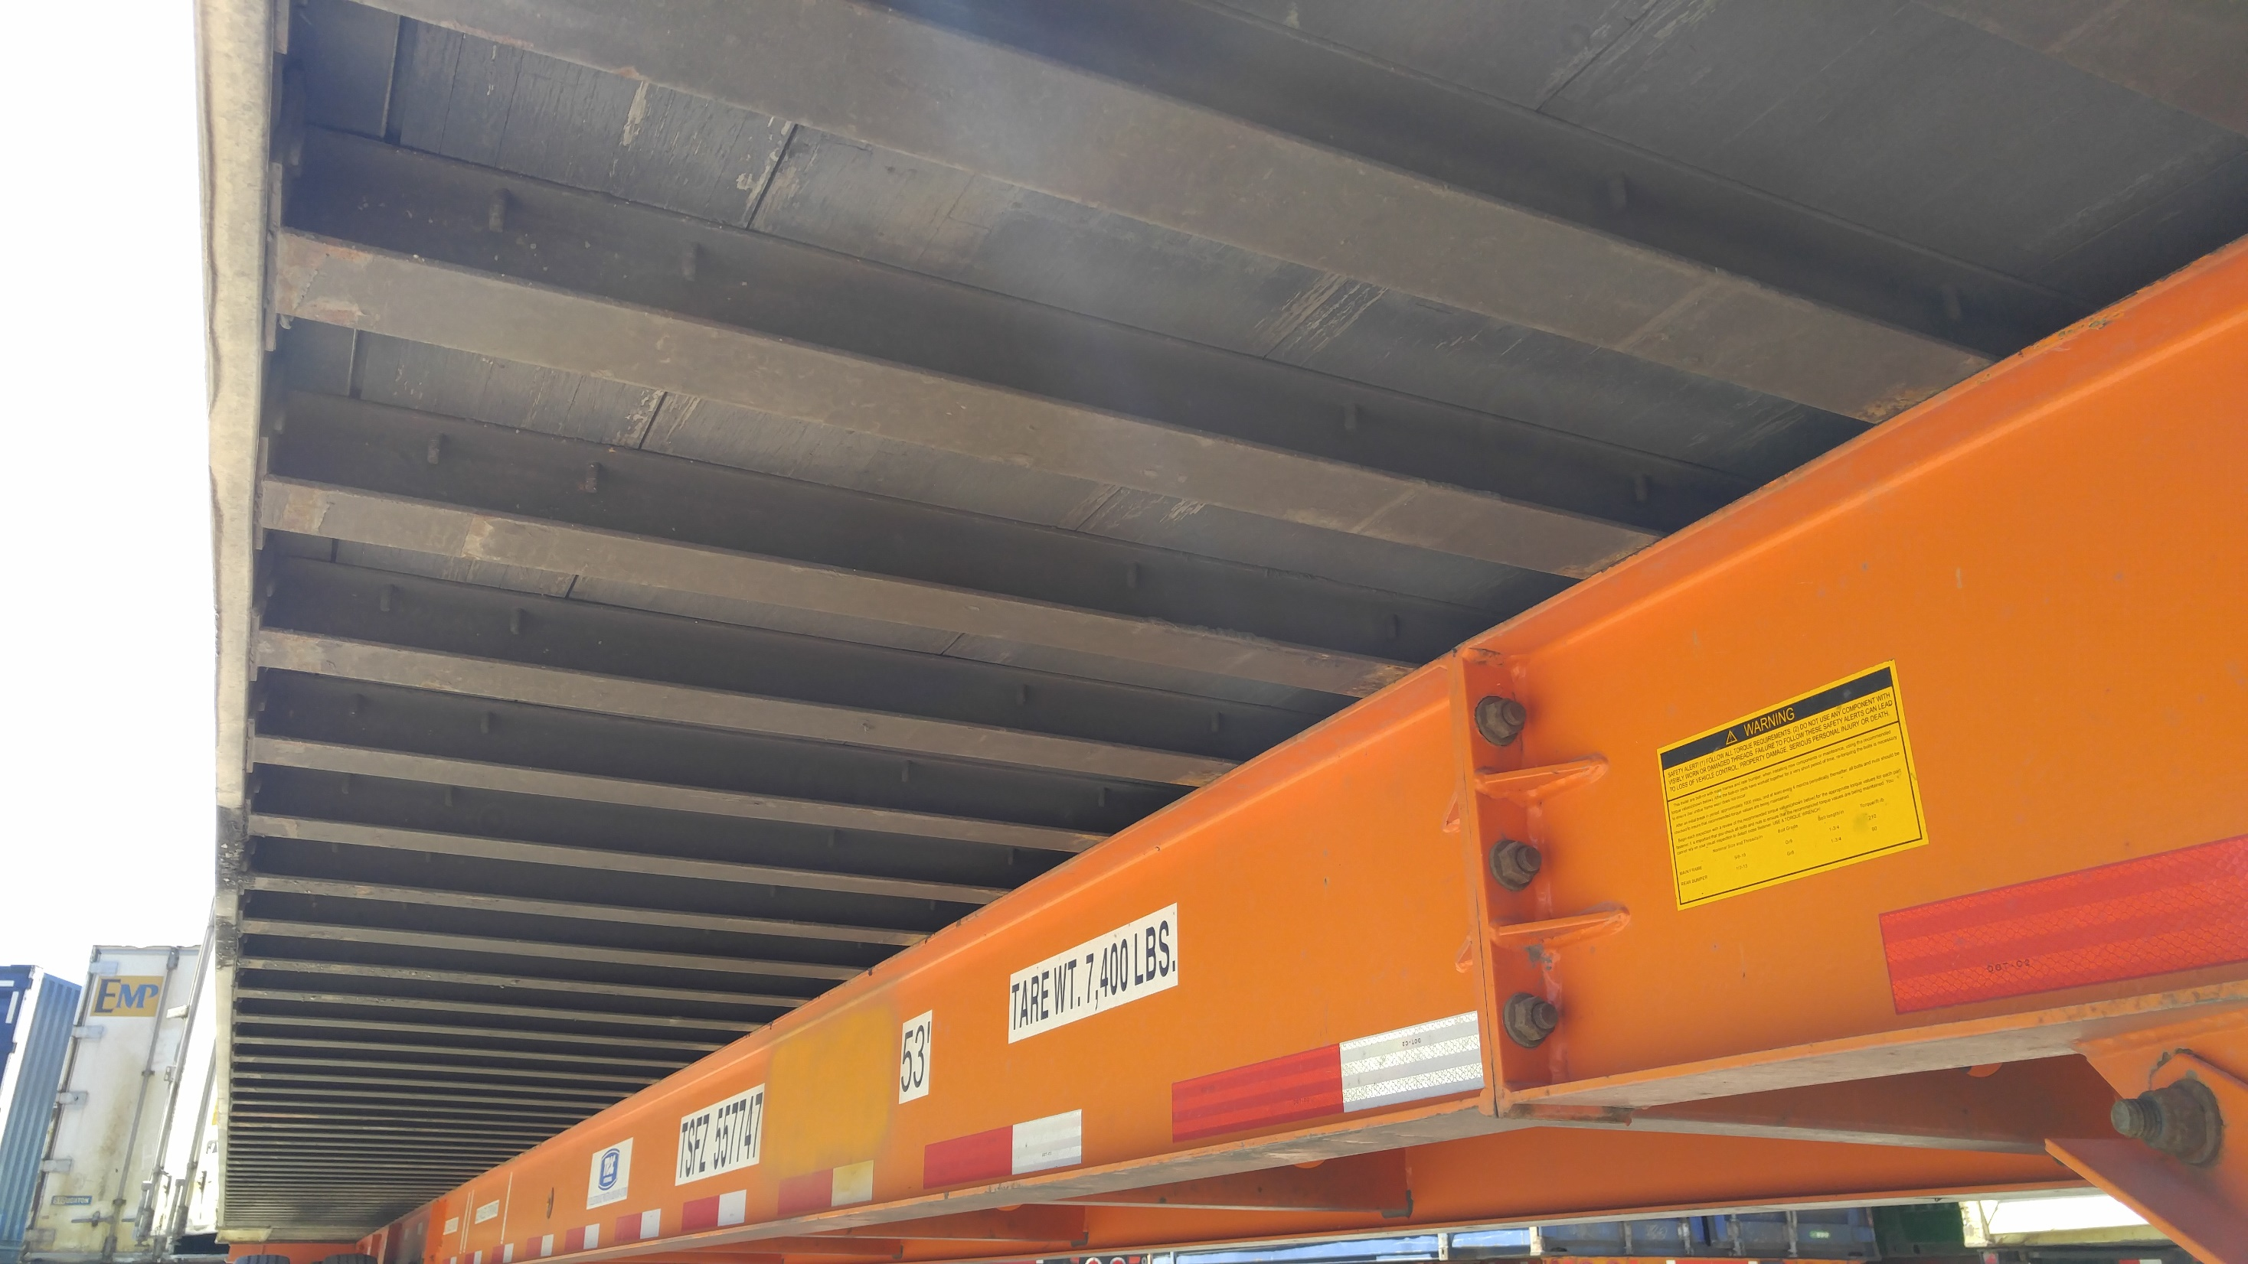
Floor
Crossmembers

Slide 13
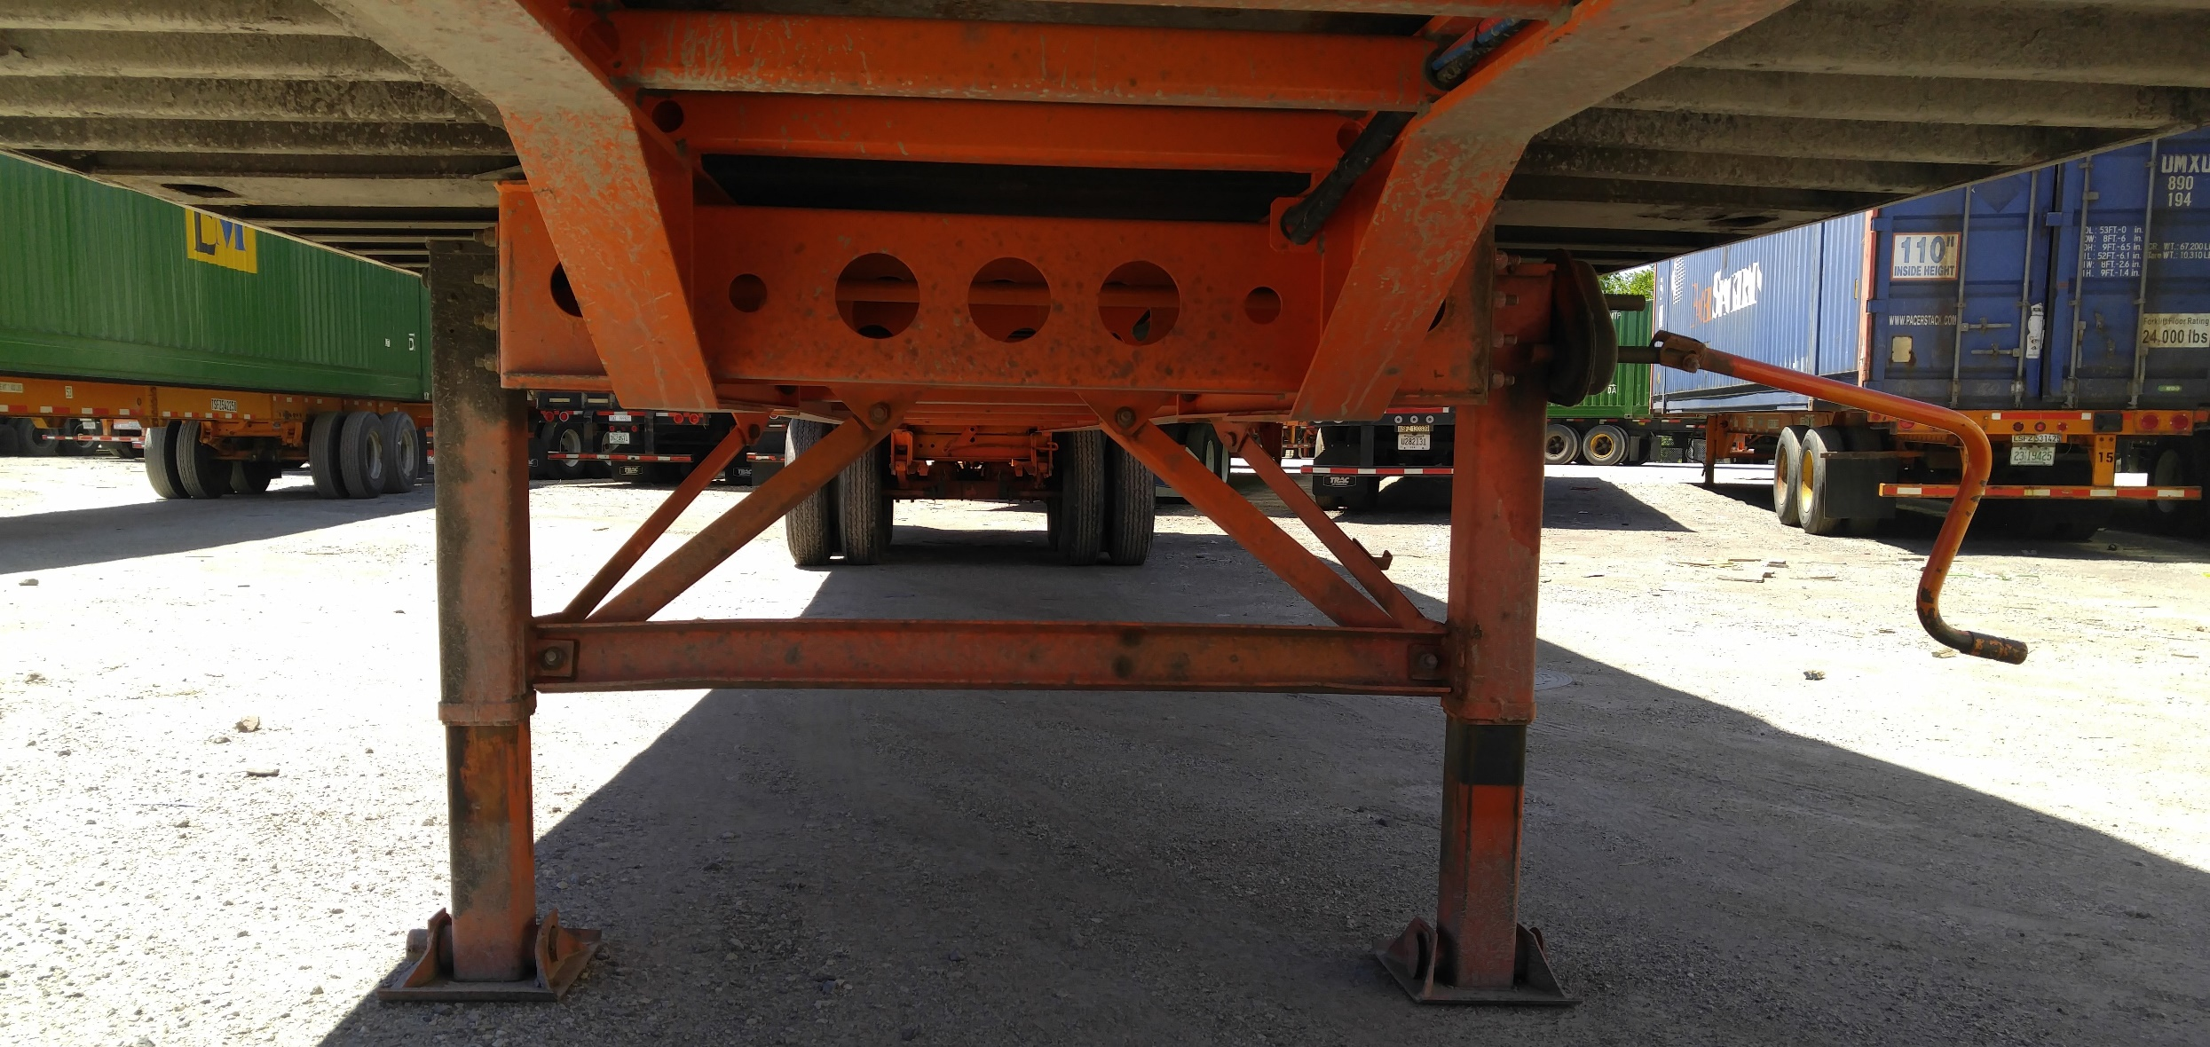
Crankshaft
Crank Handle
Diagonal Braces
Crossbrace
(RS) Non-Gear Leg
(LS) Gear Leg

Slide 14
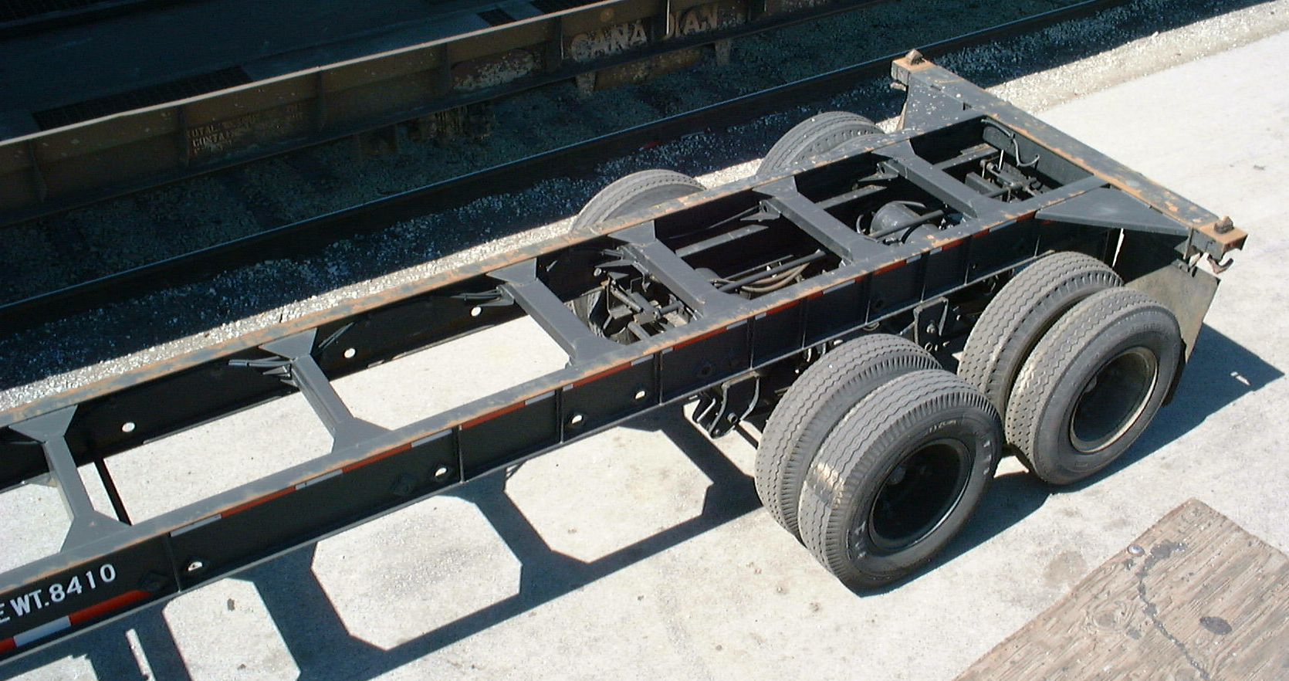
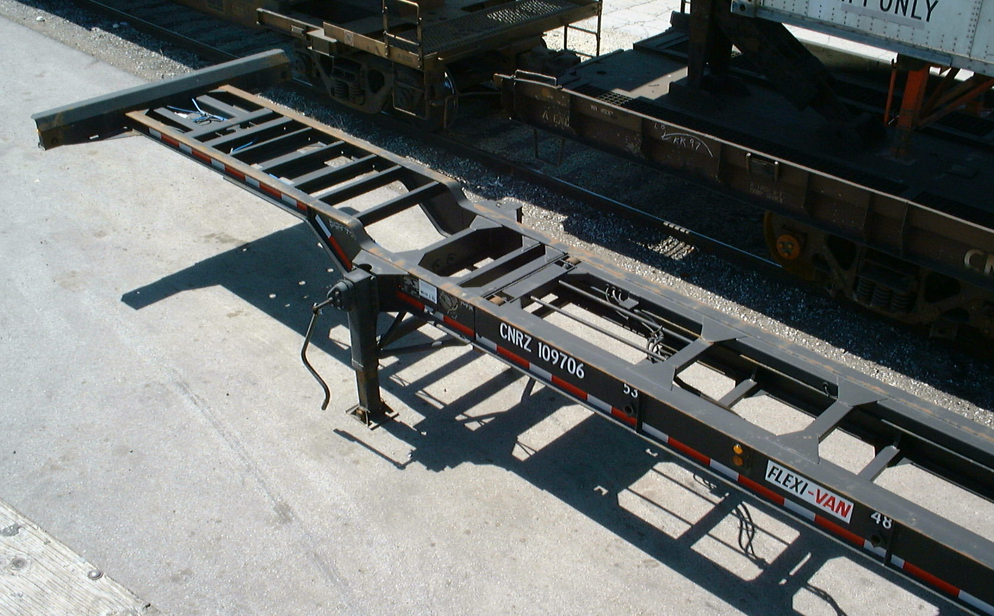
FRONT BOLSTER
RS MAIN RAIL
CHASSIS CROSSMEMBER
CROSSMEMBER GUSSET
LS MAIN RAIL
CHASSIS CROSSMEMBER
CHASSIS CROSSMEMBER
REAR BOLSTER
RS MAIN RAIL
TWIST LOCK
LOR TIRE
LS MAIN RAIL
LIF TIRE
LOF TIRE
Notes:
Chassis nomenclature

Slide 15
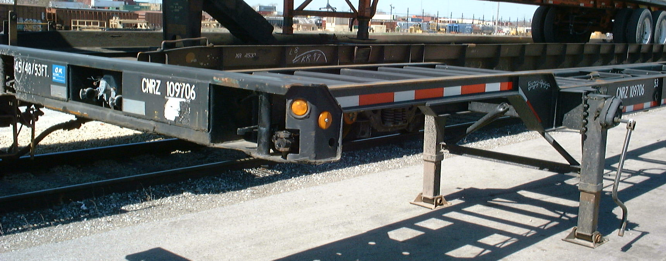
FRONT BOLSTER
GLADHANDS
RS NON-GEAR LEG
PUSH PIN LOCK
CROSSBRACE
LS GEAR LEG
Notes:
Front view of chassis

Slide 16
Three Key Words for Damage
J-2
Bent
Broken
Cut

Slide 17
4 Steps to Taking Exceptions
Location
RSF,RSC,RSR,LSF,LSC,LSR,TF,TC,TR,F,R,INT.
Item
RAIL,PANEL,DOOR,POST,ETC.
Defect
BENT,BROKEN,CUT
Dimensions
ALL DIMENSIONS ARE TO BE SHOWN IN INCHES

Slide 18
INSPECTION TIPS
Start and finish at the same location
View intermodal equipment from all angles
Inspect underframe (crossmembers, legs, etc.)
Inspect roof (if empty, open doors; if load, use cameras, mirrors or direct visual inspection)
Check all tires
Verify initials and number
If loaded, verify seal number
Make sure doors seal properly
Tape and caulk usually cover cuts and should be written on J-1 as a cut
Denote any defects
Notes:
Tips to follow when inspecting equipment
Notes:

Slide 19
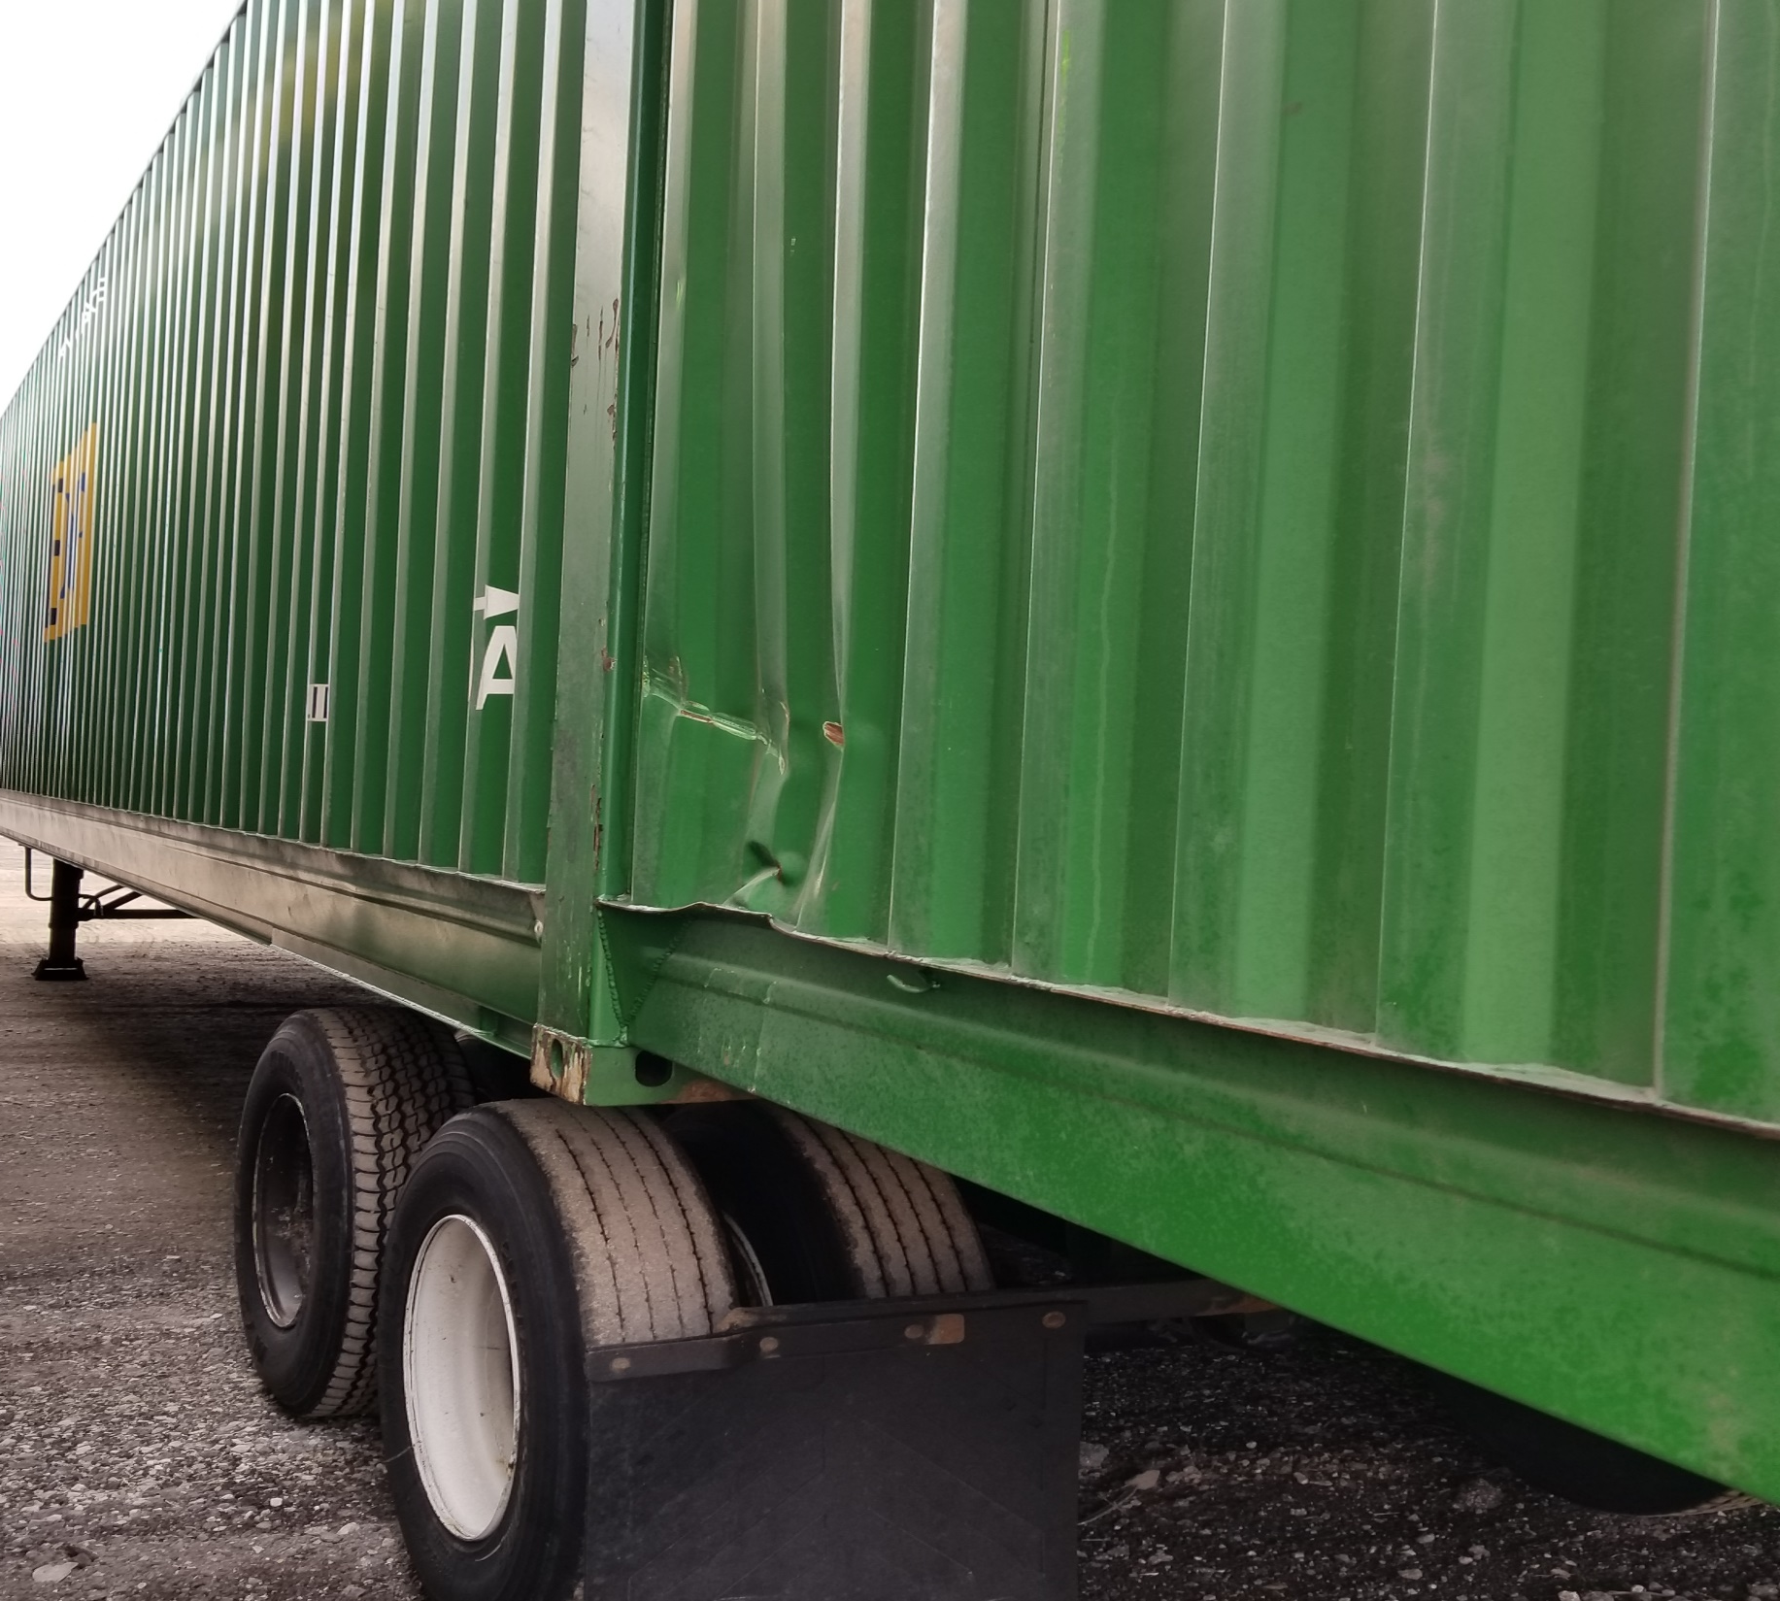
Location: Left Side Rear (LSR)
Item: Steel Side Panel
Defect: Bent
Dimension: 36”

Slide 20
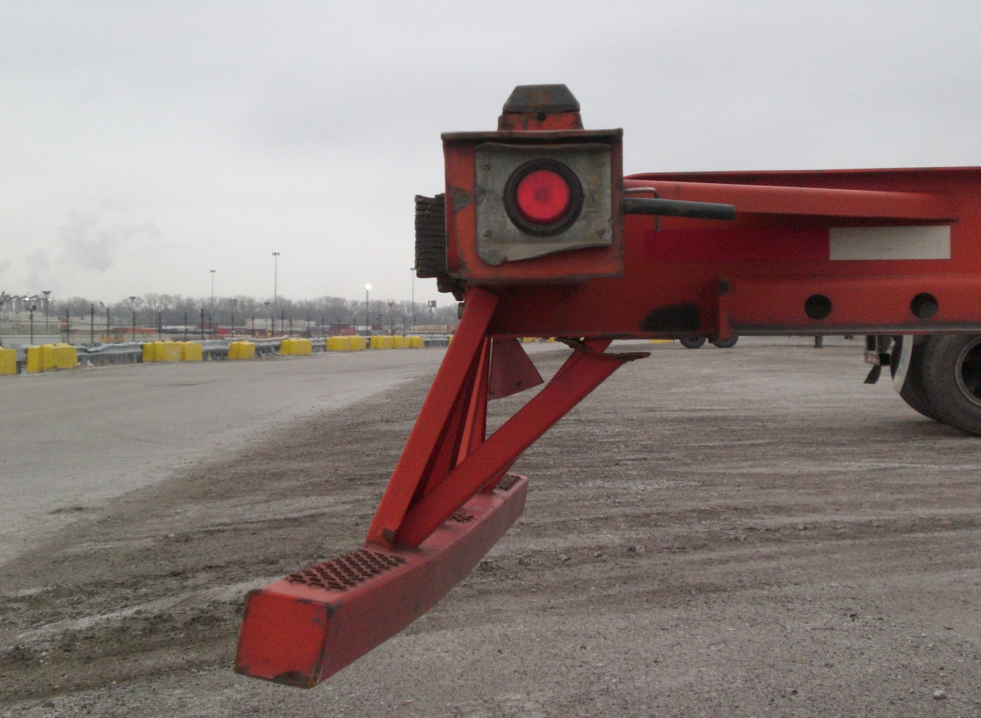
DOT UNDER–RIDE GUARD
Greater than 3” deflection in horizontal bar
> 3”

Slide 22
6/32 tread depth
0/32 tread depth
Slid Flat Tire – J2 Condition
Notes:
Damage to tire as a result of being slid flat

Slide 23
Tire sidewall cut/punctured, exposing belt material – J2 Condition
Notes:
Tire cut/punctured through one or more plies of fabric

Slide 24
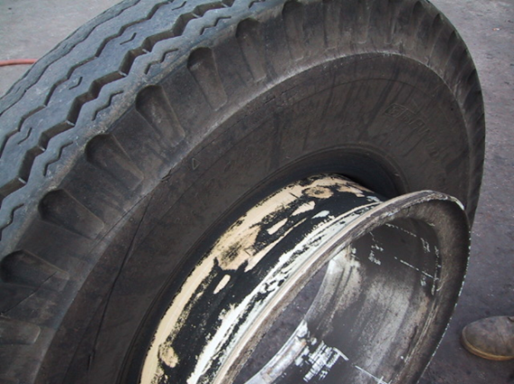
Run Flat Tire – J2 Condition
Damage to tires and tubes as a result of being run flat, resulting in discoloration, blistering,
wrinkling, and/or casing damage being evident

Slide 25
Separated Cap – Owner’s Responsibility
Notes:
Cap peeling, No Section F. damage

Slide 26
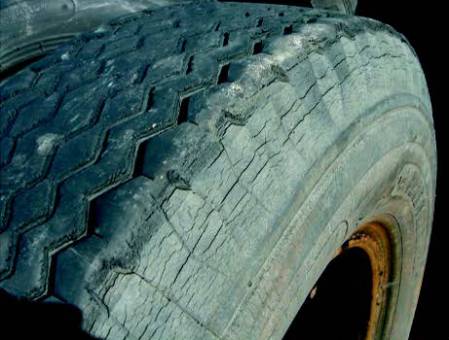
Weather Checking – Owner’s Responsibility

Slide 27
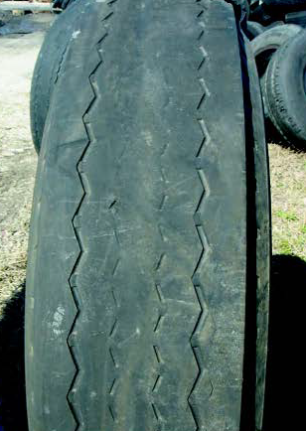
Worn Out Tire – Owner’s Responsibility

Slide 28
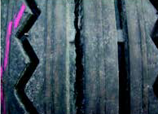
Channel Cracking – Owner’s Responsibility

Slide 29
Estimate of Repairs
Replace Noserail (Aluminum) |  |  | $629.00
Replace Noserail (Steel) |  |  | $370.00
Section Roof (4'x8' Aluminum) |  |  | $400.00
Replace Roof (Steel) |  |  | $715.00
Replace Side Panel (Aluminum) |  |  | $336.00
Replace Side Panel (Steel) |  |  | $684.00
Replace Top Side Rail (Aluminum) |  |  | $1,811.00
Replace Top Side Rail (Steel) |  |  | $2,085.00
Replace Bottom Side Rail (Aluminum) |  |  | $1,846.00
Replace Bottom Side Rail (Steel) |  |  | $2,085.00
Replace Doors |  |  | $1,114.00
Replace Doors (Steel) |  |  | $1,175.00
Replace Bias Tire |  |  | $165.00
Replace Radial Tire |  |  | $225.00
Replace Exterior Side Post |  |  | $175.00
Replace DOT Under-Ride Guard |  |  | $495.00
Replace Chassis Bolster |  |  | $1,500.00
Replace Dolly Legs |  |  | $953.00

